Slide 1
Java
I can help you create objects, I also clean up the mess. With me, you're secure, baby. Call me Java, or call me your love. Whether it's Windows, macOS, or Linux, I will come running for you anywhere you choose ☺

Slide 2
Multithreading in java
A thread is the simplest part of a process
Multithreading is multiple threads of a process run simultaneously either through context switching or through true parallelism.
In order to run with true parallelism, There must be multiple CPUs.
Otherwise context switching is going to happen
This is all in the hands of OS

Slide 3
Ok , but when it comes to java what constitutes as a process?
After compilation javac ClassName.java a byte code /class file is generated
Now if you run this class file “ java ClassName” a new process starts

Slide 4
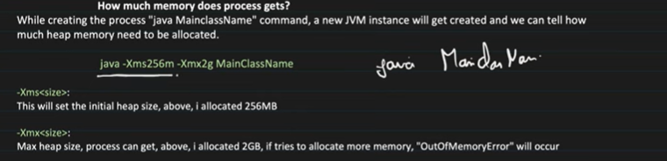
PROCESS vs THREADS
* A program in execution is called a process
A Thread is a lightweight process it is a part of a process.
* When a process is created , it starts with a single thread known as main thread . Later this main thread can give rise to more threads or it can complete by itself and terminate
* A process gets as much memory as you give it.

Slide 5
How is memory shared among processes?
Remember that two processes does not share any memory between them.
Analogy :Think it like this , Your house and your neighbour’s house. You don’t share same kitchen do you?

Slide 6
How is memory shared among threads?
Two threads can share same memory
Analogy : You are a thread, your mother is another thread and your father too. Now you all share same heap memory like say kitchen . You all access and eat rice from the same cooker too!
But when it comes to register, program counter and call stack think of that as your plate, your toothbrush , your blanket. Now you don’t share that with them .

Slide 7
PROCESS1
PROCESS2
Heap
Heap
Data segment
Data segment
CS
CS
R
R
R
R
S
S
S
S
C
C
C
C

Slide 8
Heap vs Data Segment vs Code Segment Analogy
Think Heap as same cooker rice or something , and same bowl of dal.
Think Data Segment which constitutes static and constants in java as same dining table
Think code Segment as same kitchen.
Think of Register a spoon, fork, or chopsticks—that each of you have
Think of Your Stack as your food plate
Think of Program counter to be your eyes with which you know when you are finished or what you want next

Slide 9





Heap
Code Segment
Data segment
Register and Stacks
Program Counter

Slide 10
Heap (Same Cooker Rice or Something): The heap is where Java allocates memory for objects dynamically.
Just like a cooker that cooks rice or food, the heap provides space for objects to be "cooked" or
created at runtime.
When you create an object in Java, it goes into the heap memory, where it can be accessed or manipulated
You can take rice from cooker , even your sister . What happens if you both go for it at same time? That’s why
We need synchronization
Data Segment (Same Dining Table): The data segment represents memory that stores static
variables and constants in Java. It's like a dining table where food is placed
for everyone to access. Static variables are shared among all instances of a class,
and constants hold fixed values that remain the same throughout the program.
Here also synchronization is needed what happens if both of you go for same seat !
Code Segment (Same Kitchen): The code segment refers to the area where the bytecode of your program is stored,
which is executed by the Java Virtual Machine (JVM). This is like the kitchen where all the cooking
(processing and preparation) happens before the food (your program) is served or executed.
Threads : You , your dad, Your mum , Your sister etc

Slide 11
HOW TO CREATE THREADS?
Now that we have some understanding of threads , processes and parts of it . Let’s understand how to create threads
We already know how to create a process in java . Don’t we?
Yes we know that we can create a process by ‘java ClassName’ command execution after javac ClassName.java
Now we know that this public static void main creates other threads so let’s see how to create threads

Slide 12
In real life we usually have more than one way of doing things. But we also know that there is always one better way.
In java also there are two ways to create a thread
1) By extending Thread class
2) By implementing Runnable interface

Slide 14
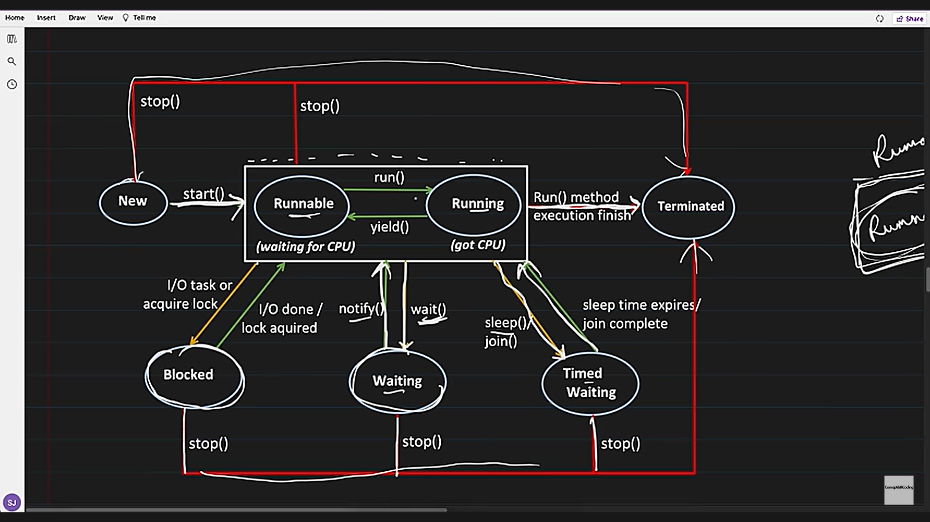

Slide 15
Different cases for executing a thread
Single task Single thread
Single task Multiple Thread
Multiple task Single thread
Multiple task Multiple thread

Slide 16

Single task single thread
1. IMAGINE I TELL YOU TO GO AND HAVE YOUR DINNER which was prepared by your mother
2. DO YOU NEED A THOUSAND PEOPLE TO DO THIS JOB?
3.NO! IT’S STRAIGHTFORWARD
4.NOW YOU MIGHT FEEL LIKE YOU NEED COMPANY , WE ALL DO BUT THAT’S ANOTHER STORY

Slide 17
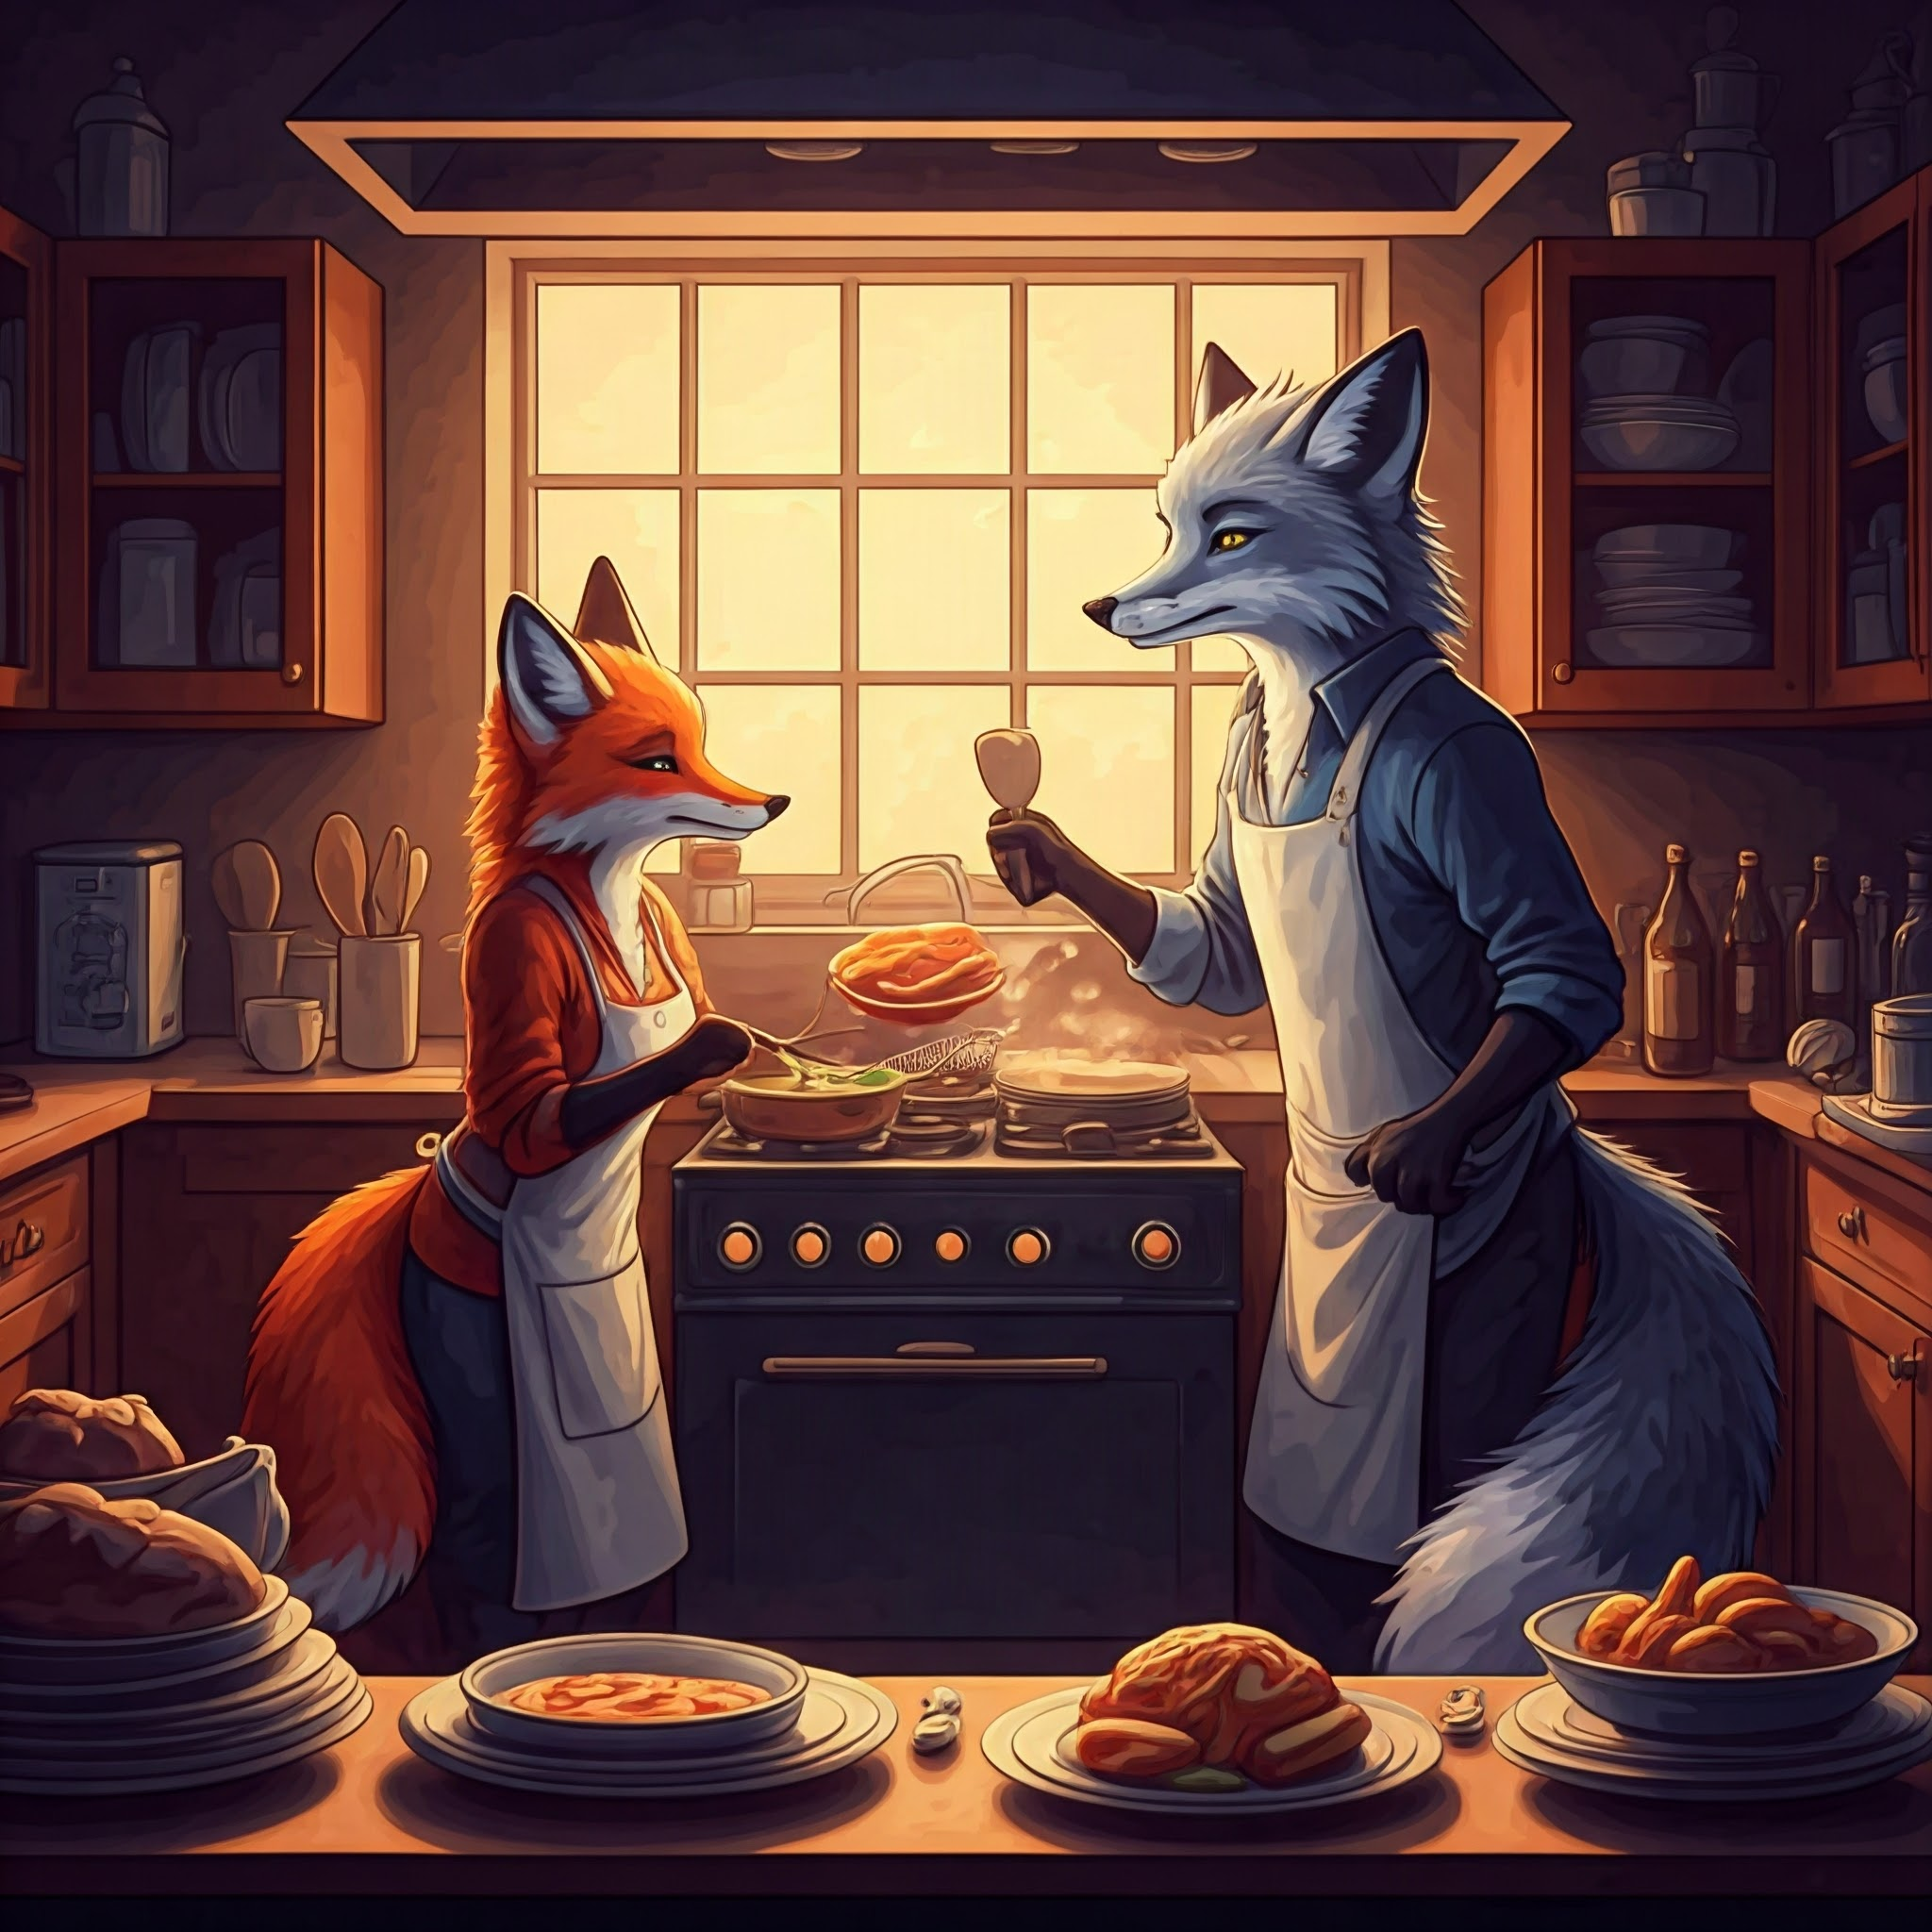

Single task multiple thread
1. Now imagine I tell you to cook and eat your dinner
2. You can of course do it , but you got to cut the vegetables, fry it then you know cook rice and etc
3. So you will feel like having someone can help you to cook faster.
4. So in cases like say we need quick processing etc which of course cannot be sequential , in such cases multiple thread for a task makes sense
So if it is sequential like I you have a dirty cloth that you need it set for office tomorrow
Itself , I cannot use multiple threads for
This kind of a task right?
* wash the cloth
* dry it
* iron it

Slide 18

Multiple task single thread
1. Now I tell you to eat your dinner with both of your hands , I will also give you a sheet of paper and ask you to type it and send me that copy
2.Now is this possible?
3.Of course if you had 2 more hands but nah , you don’t

Slide 19
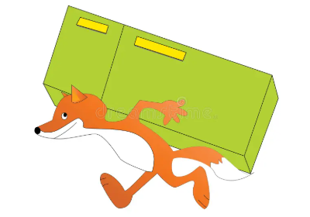

MULTIPLE TASK MULTITHREAD
1. This is used to perform a group of unrelated tasks
2.Now imagine I tell you to work on your computer
3. I tell your brother to clean his room
4. Now is this related? Cooking a peaceful meal has got nothing to do with cleaning a room
5. No, and never will.

Slide 20
Single task multiple thread
When Multiple Threads Are Redundant (Don't Help)
Sometimes, using multiple threads won’t help and will just increase complexity.
🔴 1️⃣ Single-Step Operations If a task is atomic (can’t be divided),
multiple threads won’t help.
Example: Printing "Hello World" multiple times.
Example: Fetching one simple database record.
🔴 2️⃣ Tasks That Must Run Sequentially If one step
depends on the previous step, multiple threads won’t help.
Example: Reading a file line by line in order.
Example: Logging messages in exact order.
🔴 3️⃣ Small Tasks (Thread Creation Overhead) If a task finishes quickly,
the overhead of creating multiple threads slows it down instead of speeding it up.
Example: Summing 100 numbers (too small for multithreading).

Slide 21

DAEMON THREAD
Daemon thread provides service to another thread
ANALOGY : Think of it like a motion sensor light that only
switches on only if a person comes in it’s vicinity and stays
on only until they leave
OTHERWISE :it’s off that’s it

Slide 23
Oracle reference for threading
https://docs.oracle.com/javase/tutorial/essential/concurrency/procthread.html s

